Slide 1
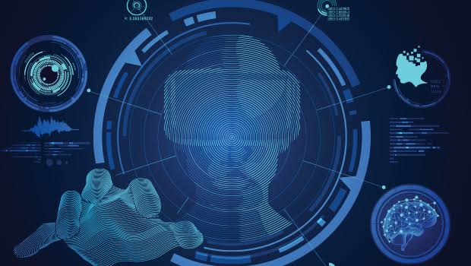
( Virtual reality, simulators)
Immersive technology
Presented by:
Arjay Buen
Jhennica Ela Roaring
Myrell Concepcion

Slide 2
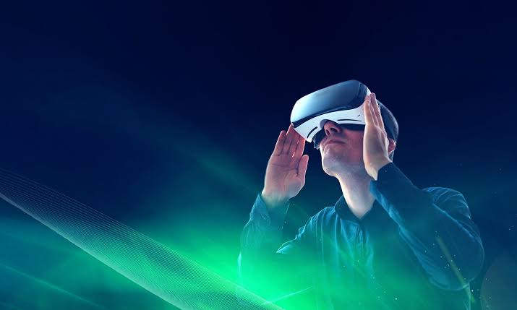

What is Immersive technology?

Slide 3
Immersive technology
-Refers to the technology that is used to create a virtual world for its users.
-example of this are virtual reality and augmented reality
-Immersive technology uses a simulated world to create the feel of being in a physical world.
-this surrounding sensory feeling felt by the user gives the user sense of immersion in real life setting

Slide 4
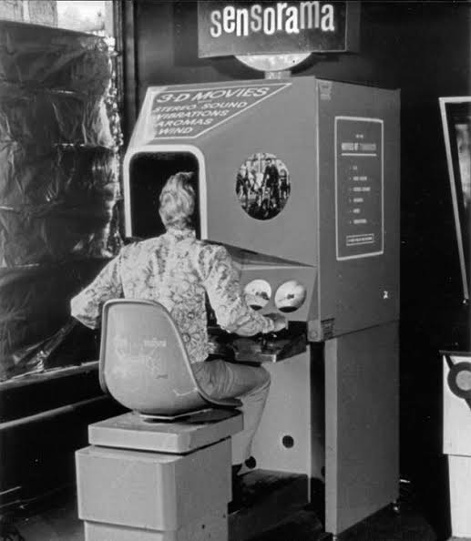
History of virtual reality
More than one person has been involved in the development of this technological system.
In 1950’s visionary cinematography Morton Heilig built a single user console called Sensorama. This enabled the user watch television in 3 dimensional ways which it includes sounds and smells.

Slide 5
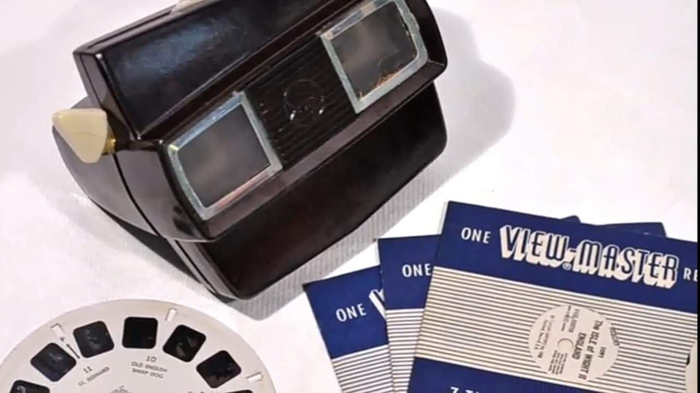
Also we started to see things like the View Master that got created it is a goggle that would show pictures which builds the foundation of virtual reality headsets that we see right now.

Slide 6
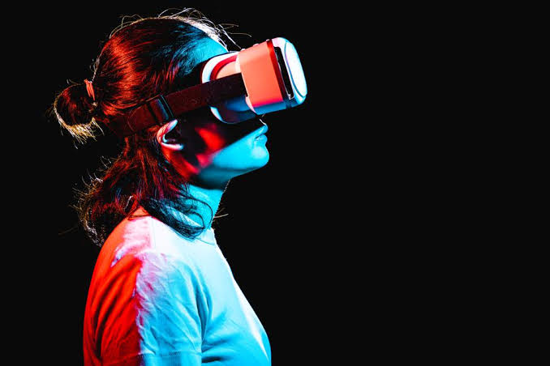
What is
Virtual Reality?

Slide 7
Virtual reality
The concept of virtual reality is built on the natural combination of two words: virtual and the real. The definition of “virtual” means nearly or conceptually and “reality” is what we experience in everyday living, which leads to an experience that is near- reality through the use of technology which in this simulated artificial environment, the user is able to have a realistic-feeling experience.

Slide 8
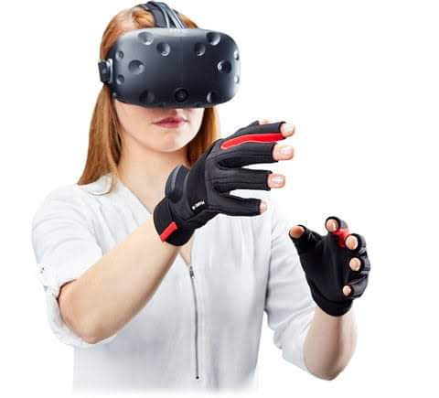
Software creates and simulates an artificial three dimensional environment that are experienced by the users who wear hardware devices, such as special goggles with a screen or gloves fitted with sensors.

Slide 9
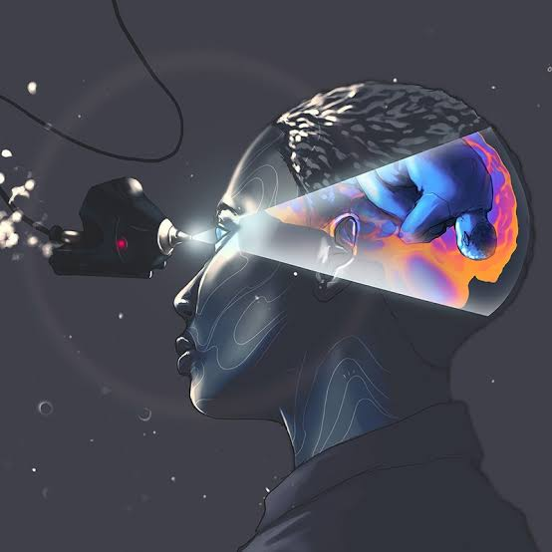
-In virtual reality through our
sense of sight the inputs gathered
by these senses are processed by
our brains to make interpretations
of the objective environment around
us.
-Virtual reality attempts to create
an illusory environment that can be presented to our senses with artificial information, making our minds believe it is (almost) a reality.

Slide 10
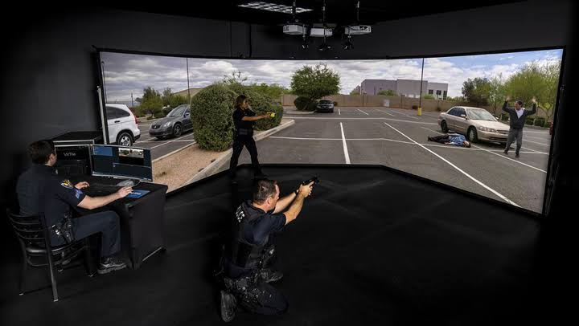
Application of virtual reality
Use for Military Training

Slide 11
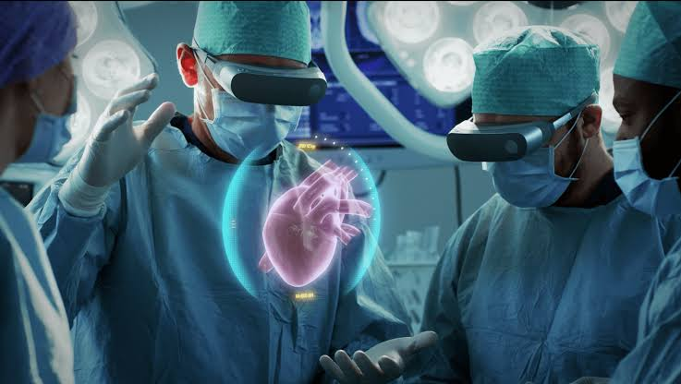

Use for Medical Treatments
Use for Medical Training

Slide 12
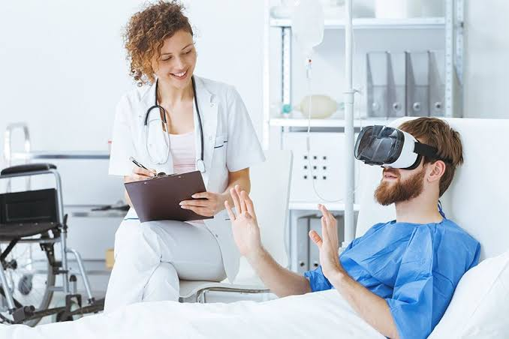
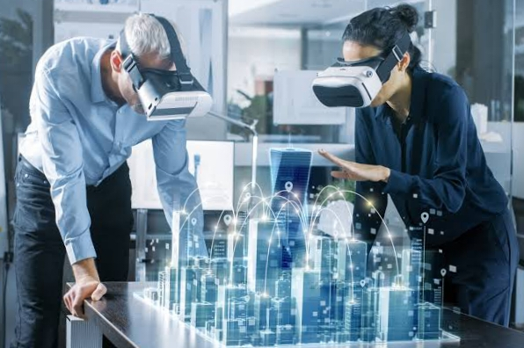
Use for Mental healthcare
Use for Business

Slide 13
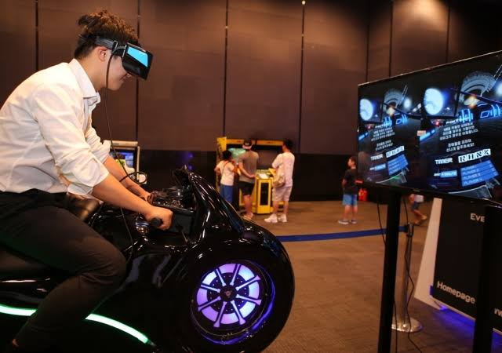
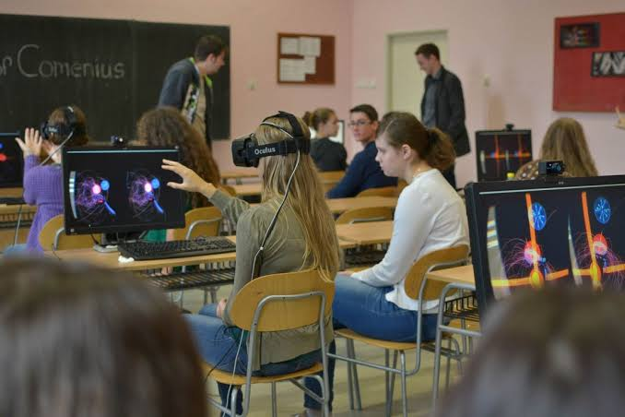
Use for Entertainment/ Games
Use for Education

Slide 14
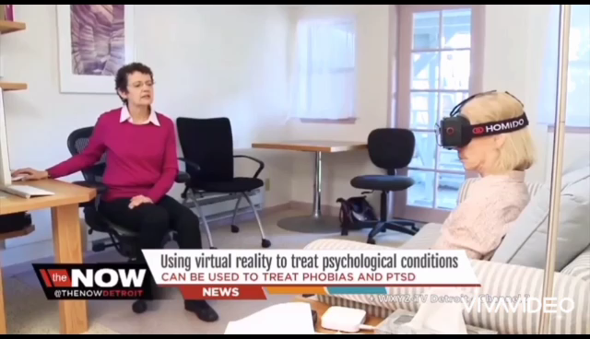

Slide 15
Advantages
Virtual reality creates a realistic world
It enables users to explore places
Through virtual reality users can experience with an artificial environment
Virtual reality make the educationmore easily and comfort

Slide 16
Disadvantages
The equipments use in virtual reality are very expensive
It consists of complex technology
In virtual reality environment we can't move by our own like in the real world
Feeling of worthless
Physical sode effects

Slide 17


